Slide 1
Data Analysis On Airlines In India
Name :-Amit Sadarang
Reg. no. :-11612527
Section no. :- RKEM45
Roll no. :-B55

Slide 2
Introduction
The Data Analysis in Airlines with the data sets and information related to passenger that traveled airline in India.
so that we analyse the data of Airline in order to increase :-
Ticket sale, Booking analysis and customer satisfaction
To reduce ticket sales barriers and low revenue levels .
We create standardized and customized reports That analyse everything from quantitative data to sales funnel flow to future need forecasts.

Slide 3
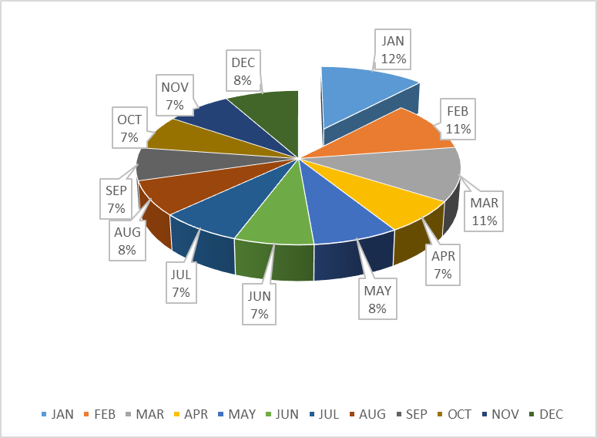
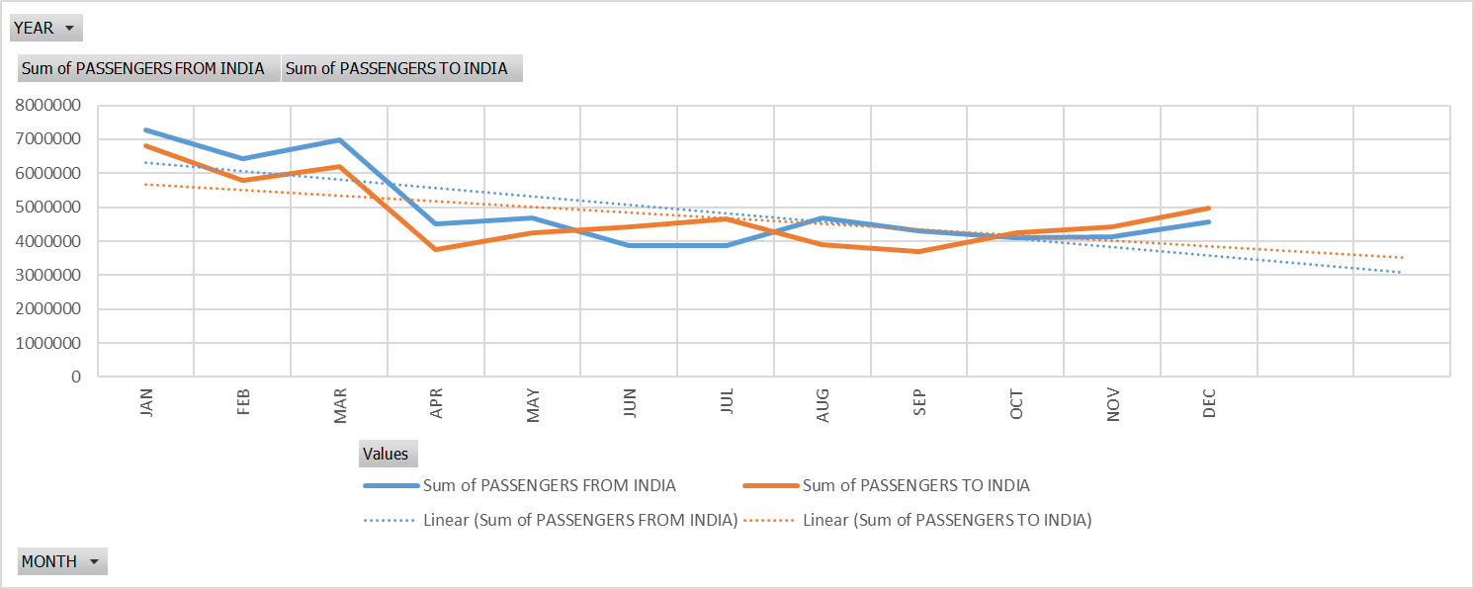
Analysis the variation of the total number of passengers travelled in each Month
Analysis of this result is that we the highest number of passengers traveled in January month with 12%,February with 11%,March with 11%.
So we can predict that January is the best month in which most of the passenger traveled from airline.
February and March is also the second highest month in which most of the passenger traveled from airline.

Slide 4
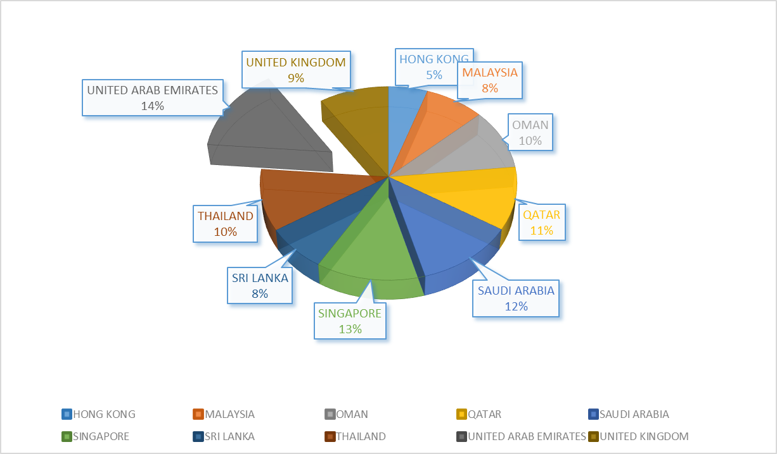
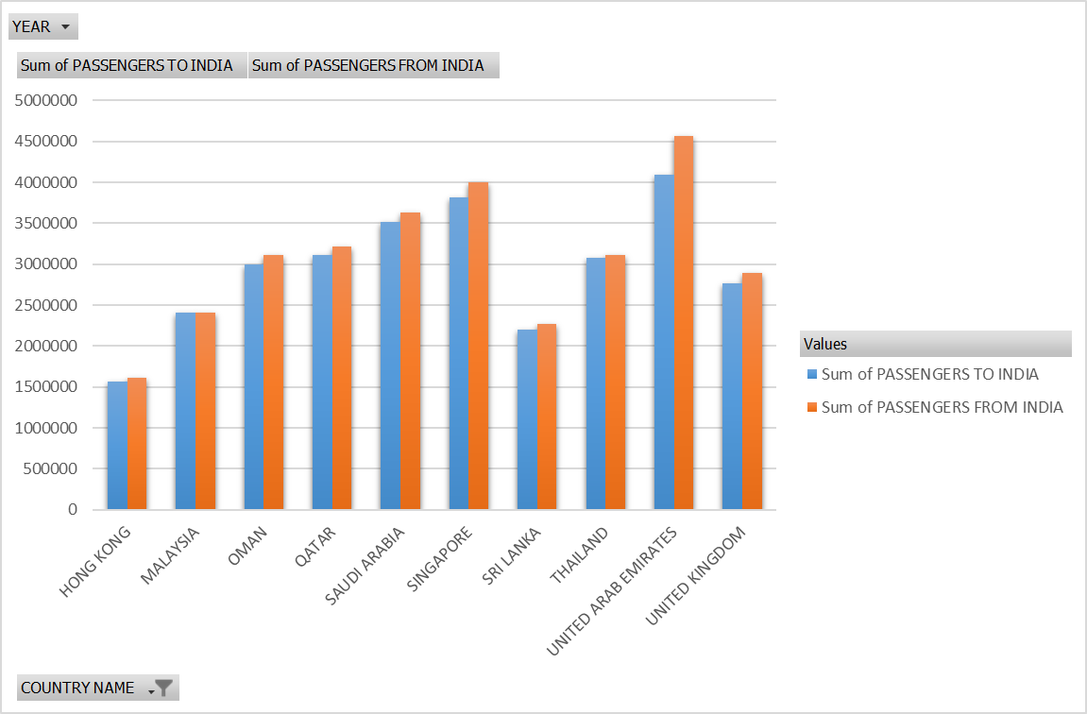
Analysis the top Most Country where the most number of passenger travelled between India and other country:-
we the highest number of passengers travelled in top 10 countries like :-
United Arab Emirates with 14%,Singapore with 13%, Saudi Arab with 12%.
So we can predict that United Arab Emirates is the best country in which most of the passenger travelled from airline.
Singapore, Thailand and Omen is also the country in which most of the passenger traveled from airline.

Slide 5
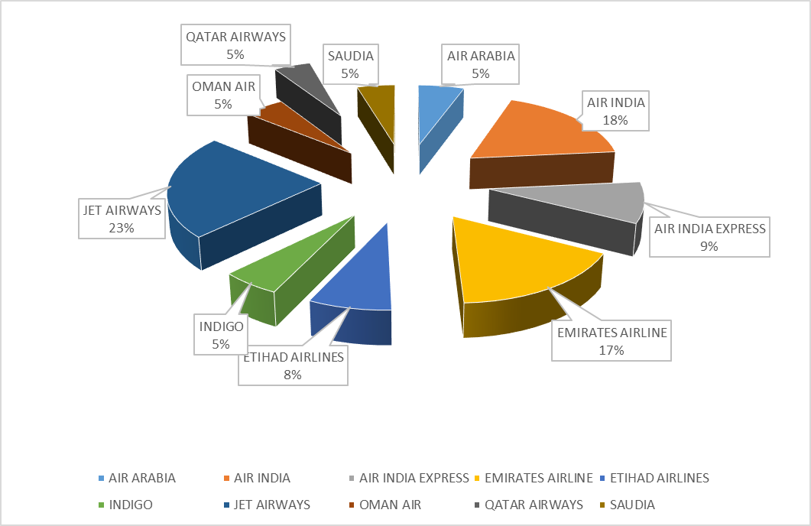
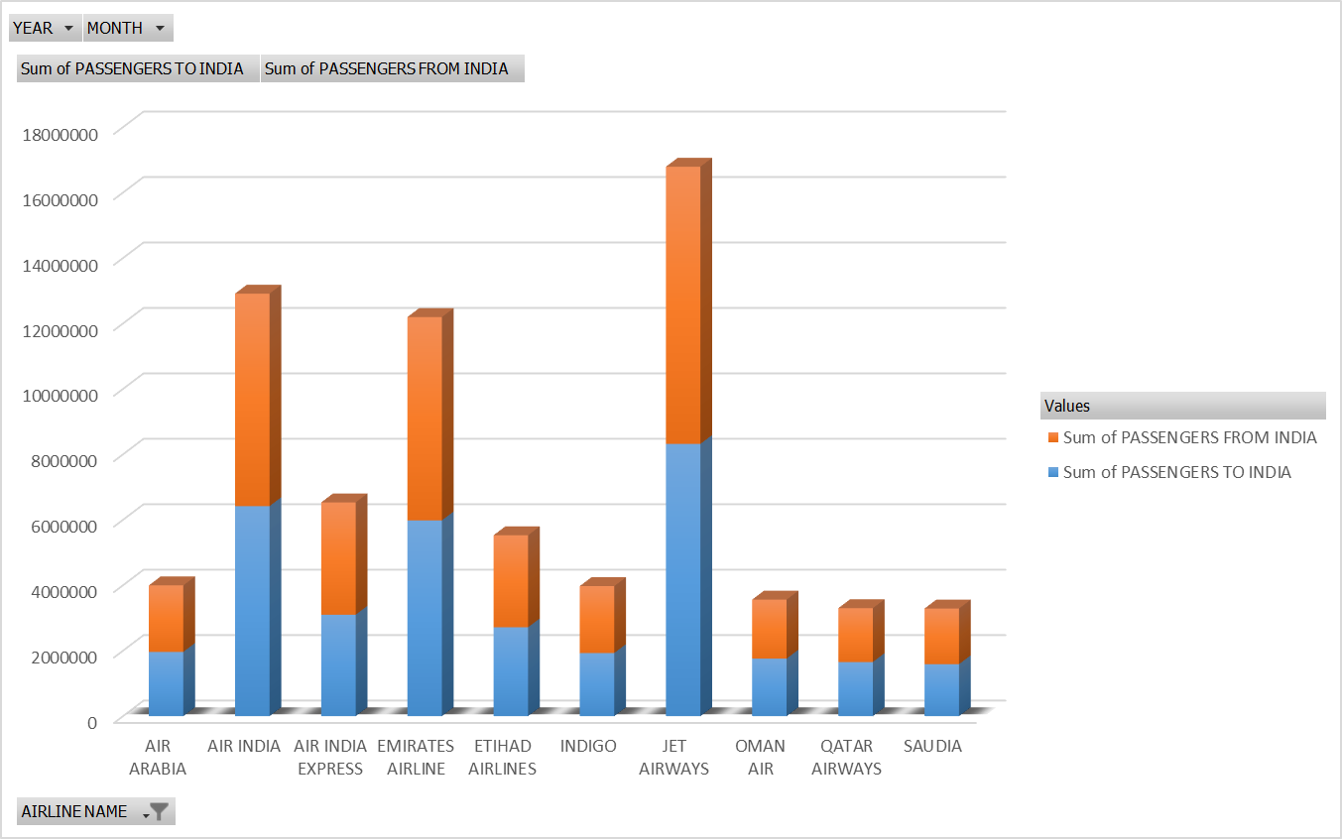
Analysis the Best Airline chosen by the number of passenger travelled in Airline:-
the highest number of passengers travelled in airlinelike :-
Jet Airways with 23%, Air India with 18%, Emirates Airline with 17%, Air India.
So we can predict that Jet Airways is the best airline in which most of the passenger travelled from airline.
Air India and Emirates Airline is also the second and third highest Airline in which most of the passenger travelled from airline.

Slide 6
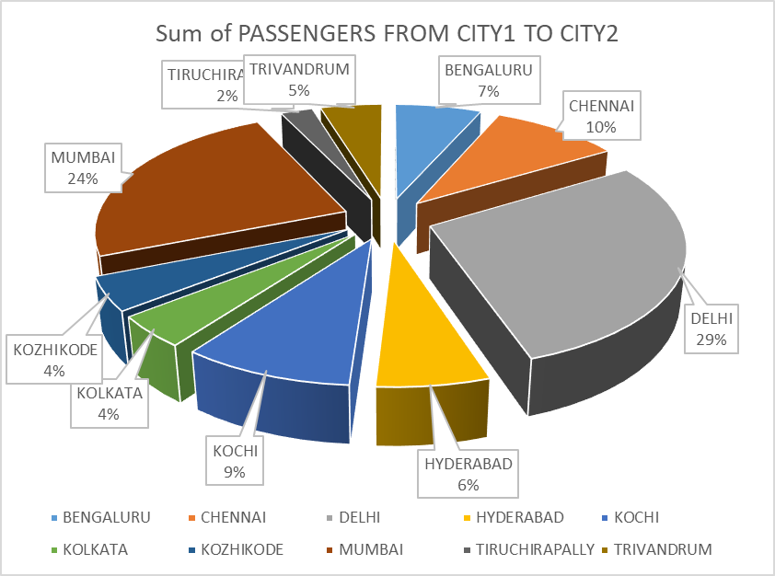
Analysis the top best Airport visited by the passengers who traveled in India:-
Airport in which the highest number of passengers travelled in like:-
Delhi with 29%, Mumbai with 23%, Chennai with 10%, Hyderabad with 6%.
So we can predict that Delhi is the best airline in which most of the passenger travelled from airline.
Mumbai and Chennai Airline is also the second and third highest Airprt in which most of the passenger traveled from airline.

Slide 7
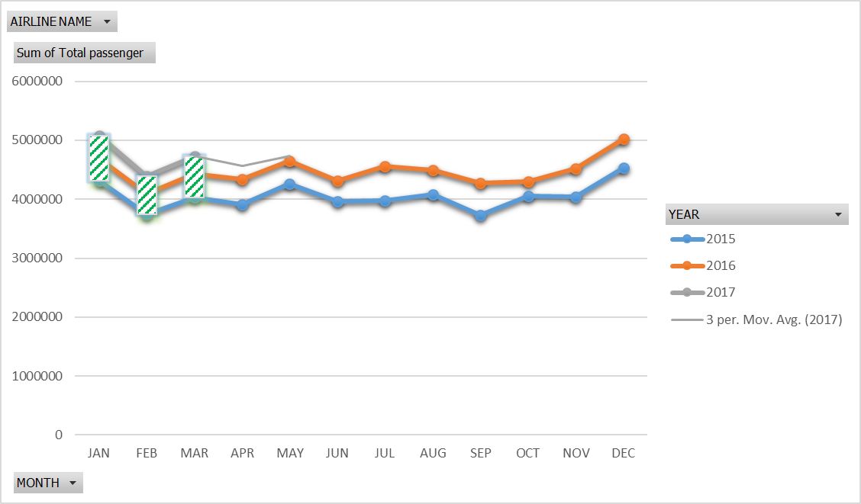
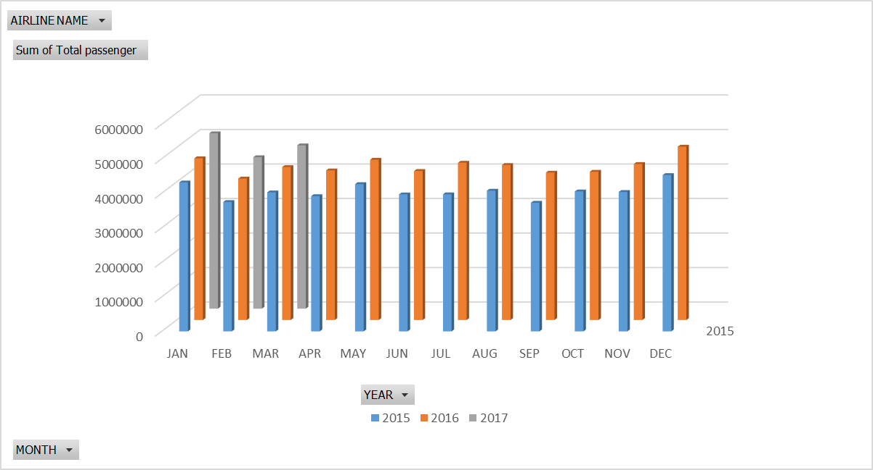
Analysis the variation of the number of passenger travelled in each year by every airlines :-
Each Year the number of passenger travelled from the Airline is increased .
Best month is January in which most of the passenger travelled from airline. Air India according to three year.
Jet Airways is the best airline in which most of the passenger traveled from airline according to three year .

Slide 8
Conclusion:-
In order to increase Ticket sale,Booking analysis and passenger customer satisfaction .
we analyse everything from quantitative data to sales ticket infuture need forecasts:-
1> January is the Best month in which Most of the passenger travelled.
2> United Arab Emirates is country in which Most of the passenger travelled.
3> Jet Airways is Airline in which most of the passenger travelled.
4> Delhi Airport is most visited airport in which most of the passenger travelled.
5> Every year the number of passenger travelled in airline is increased.

Slide 9
THANK YOU

